Slide 1
AI, ML, DL & Related Topics
(Refresher)

Slide 2
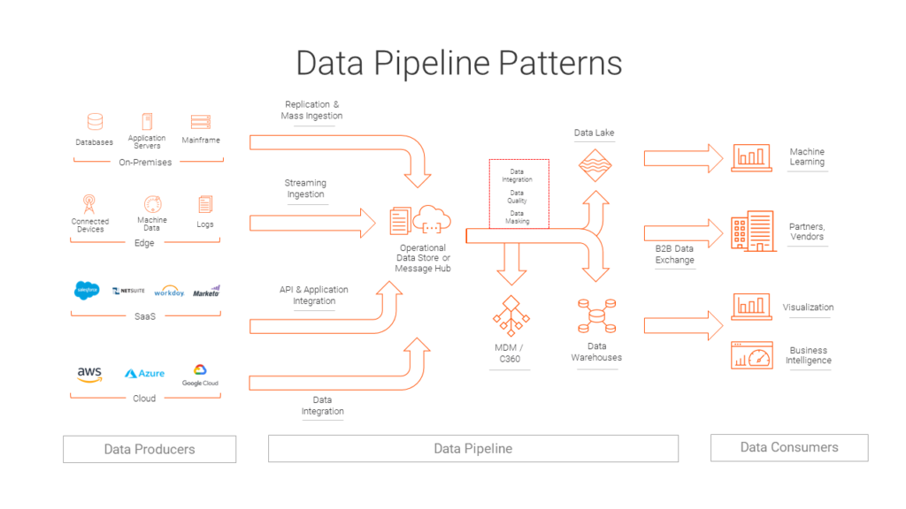
Data Pipeline
For Further Exploration –
Data Engineering Pipeline
The 6 Categories of Data
DB Types
Also , can refer Data (Engineering) slides in the “Software Architecture and Patterns “ Training Session Slides

Slide 3
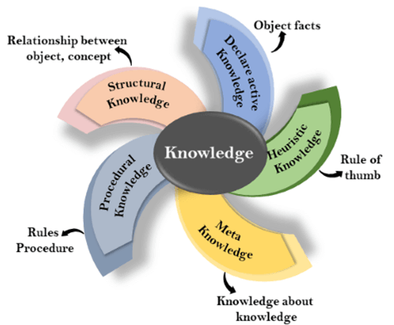
Knowledge Representation
For Further Exploration –
Knowledge Based Agent
A Knowledge Representation Practionary
Data types In Machine Learning

Slide 4
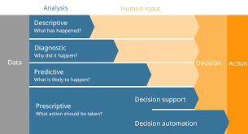
Data Analytics Types
For Further Exploration –
8 Types of Data Analysis
What Is Diagnostic Analytics? How It Works and Examples

Slide 5
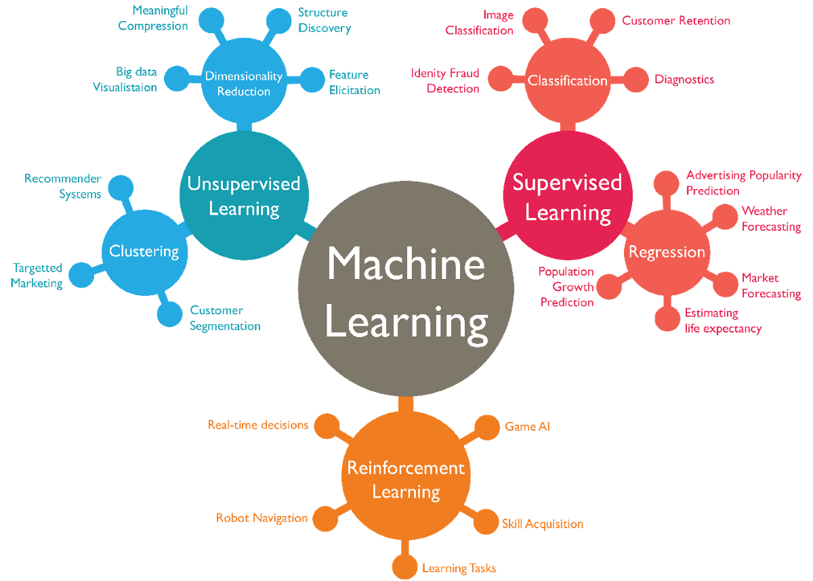
ML Types & Algorithms
N.B. - Some ML algos are based on parametric models while some are based on non-parametric models but most DL algos are based on parametric models
For Further Exploration –
4 Types of Learning in Machine Learning Explained
A Tour of Machine Learning Algorithms
Parametric and Nonparametric Machine Learning Algorithms - MachineLearningMastery.com
What are Parametric Algorithms in Machine Learning??
Algorithm & component reference

Slide 6
Supervised vs Unsupervised vs Semisupervised vs Selfsupervised vs Reinforcement Learning
Supervised Learning – Both x & y are known in general for y = f(x)
Regression - mainly represented by equations e.g. y = ax + b and here y is some numerical value while x can be numerical or categorical data
Classification – mainly represented by inequalities which detects specified regions/classes e.g. if ax+b > m then o/p data belongs to some class1 else class2.here y in general is some categorical data.
Unsupervised Learning – for y = f(x), y is not known but x known
Clustering/Grouping - e.g. doing customer segmentation for marketing/sales Analytics to find groups of customer sales(may be as per regions)
Association Learning - e.g. finding an inference that nappies & baby powder are bought together & so they should ideally be placed nearby in a physical retail store for more sales
Dimensionality Reduction - It’s always advisable to reduce dimensions as much as possible without losing any valuable info, to minimise the “Curse of Dimensionality”.
Semi Supervised Learning – Semi-supervised learning uses a small amount of labeled data alongside a large amount of unlabeled data to train a model.
Self-supervised learning – This is a machine learning paradigm where a model learns from unlabeled data by generating its own supervisory signals. It allows models to learn useful representations from data without relying on human-annotated labels. There is not even a small amount of labeled data like Semi Supervised Learning & all data is unlabeled.
Reinforcement Learning - The purpose of reinforcement learning is for the agent to learn an optimal (or near-optimal) policy that maximizes the reward function or other user-provided reinforcement signal that accumulates from immediate rewards.
N.B. - Some ML algos are based on probabilistic models while some are based on deterministic models but most DL algos are based on probabilistic models.
For Further Exploration –
Machine Learning Algorithms
Which machine learning algorithm should I use? - The SAS Data Science Blog
Semi-Supervised Learning: Techniques & Examples
Self-Supervised Learning: Definition, Tutorial & Examples
Machine Learning Cheat Sheets
Machine-Learning-Algorithms
Mastering-Machine-Learning-Algorithms
HandsOn-Unsupervised-Learning-with-Python
Hands-on Unsupervised Learning Using Python

Slide 7
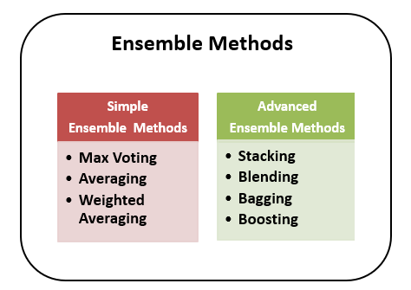
Ensemble Learning
For Further Exploration –
Ensemble Methods in Machine Learning - Prwatech
Ensemble Learning Algorithms Cheatsheet
ensemble-methods-notebooks
Ensemble-Machine-Learning-Cookbook
Hands-On-Ensemble-Learning-with-Python

Slide 8
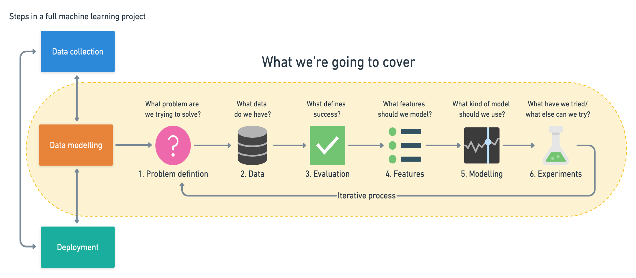
ML Workflow
For Further Exploration –
Introduction to CRISP DM Framework for Data Science and Machine Learning

Slide 9
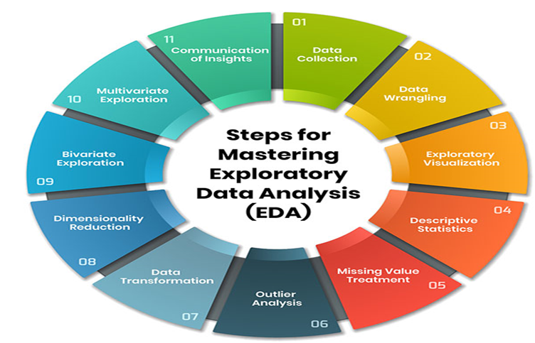
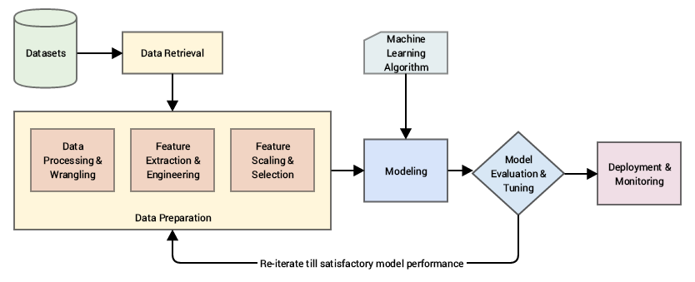
EDA(Exploratory Data Analysis) And Feature Engineering
For Further Exploration –
Data Cleaning In 5 Easy Steps + Examples
A Comprehensive Guide to Mastering Exploratory Data Analysis
How to Handle Big-p, Little-n (p >> n) in Machine Learning - MachineLearningMastery.com
Detecting and Treating Outliers | Treating the odd one out!
Data Leakage in Machine Learning - MachineLearningMastery.com
Data Science from Scratch
Fundamentals of Data Visualization
What is Feature Engineering?
What is Feature Scaling and Why is it Important?
Feature Selection in Machine Learning
Transfer Entropy for Feature Selection
Assumption Selection and Feature Selection
Categorical data: Feature crosses
Python-Feature-Engineering-Cookbook
Feature Engineering for Machine Learning

Slide 10
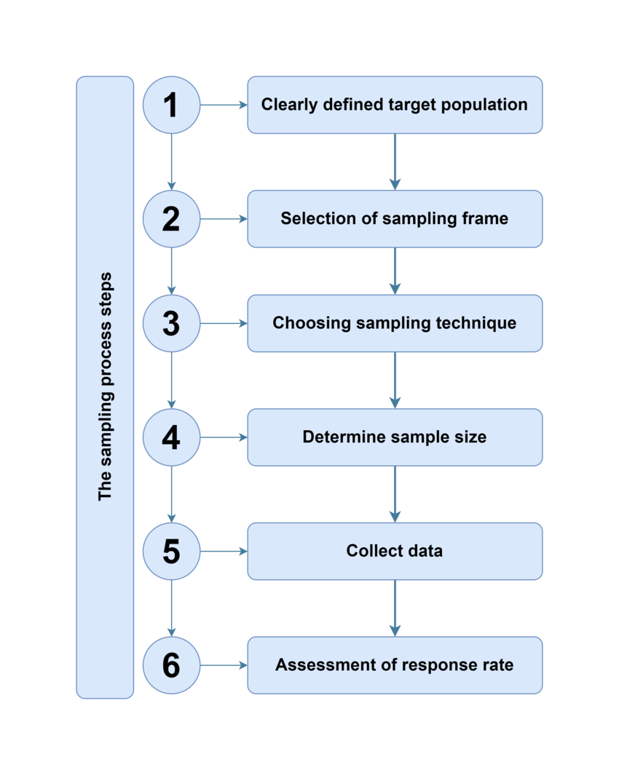
Sampling
For Further Exploration –
About Sampling
Sampling Methods | Types, Techniques & Examples
statistics - Population vs Sampling Frame vs Sample
How does sampling frame and sampling unit influence your sample size calculation?
Statistics and Probability | Khan Academy

Slide 11
Imbalanced Data
In Classification, even after sampling(or even without any sampling) there might be a case of Imbalanced Data(e.g. in a classification task, there can be 3 classes & majority of input data pointing to class 1 & a very low minority of input data pointing to class2 & class3) & to tackle Imbalanced data, mainly re-sampling training data or loss functions like class-balanced loss(CB Loss: Class-Balanced Loss Based on Effective Number of Samples (Image Classification)) or focal loss(Focal Loss : A better alternative for Cross-Entropy) are used.
Some other good articles relevant to imbalanced data are Cost-Sensitive Learning for Imbalanced Classification & www.cheatsheets.aqeel-anwar.com

Slide 12
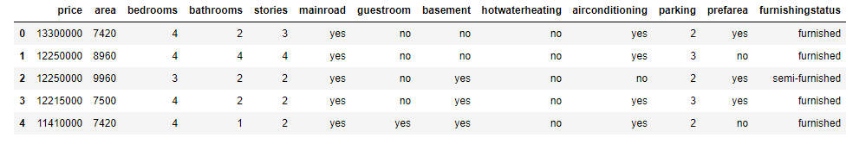

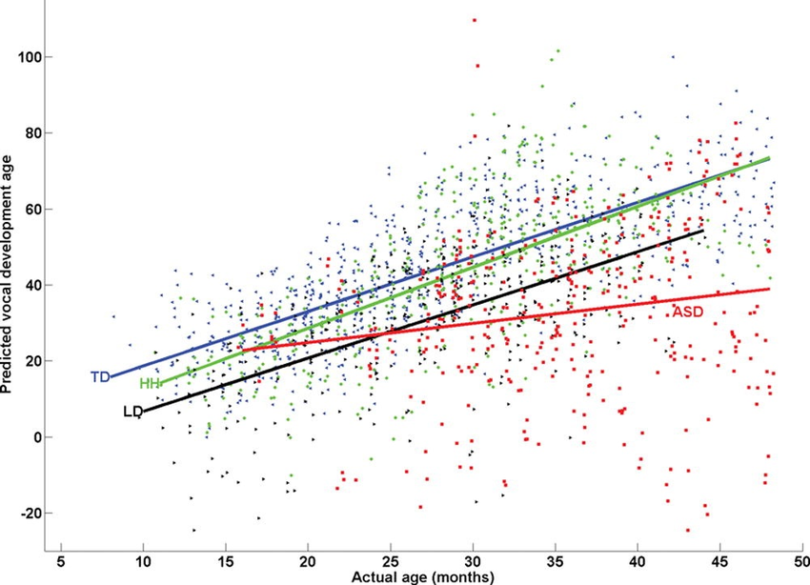
Predictive Analytics Intro Example & y = f(x)
Most AI/ML/DL etc Algorithms’ intent is to find f(x) in “y = f(x)” based on data provided for x(& y). Mainly x & y here are multivariable(i.e. a variable that can contain many values at different times of measurements) i.e. tabular data of samples of x(& y) e.g. as below –
And such f(x) is called parametric model when you assume the form of the function(e,g, linear, quadratic etc) & non-parametric model if no assumption regarding function’s form is there.

Slide 13
Maths for AI, ML, DL etc
i) Statistics & Probability - Very helpful for Descriptive Analytics(including EDA[Exploratory Data Analysis] & to some extent DV[Data Visualization]) & can provide non-deterministic/probabilistic values as needed by Linear Algebra data representation below. Also, can be helpful in handling uncertainity, quantifying likelihood, assessing model performance etc. ii) Linear Algebra - Representing (non-)deterministic values in the form of sparse(/dense) vectors/matrices in efficient array or other structures & further (parallel) processing like inferential statistics(for non-deterministic values), proximity measures(e.g. distance or similarity[in general normalized-distance = 1 - normalized-similarity]), matrix factorizations etc to gain insights via proper model development. iii) Multivariable Calculus - mainly used for optimizing the (hyper)parameters of the model or representing the Scientific ML Modelling equations(similar to linear regression).Again here (hyper)parameters can be stochastic as well wherein the values in general are non-deterministic/probabilistic. iv) Topology/Geometry - Topological/Geometric Intuition behind the Probability, Linear Algebra & Calculus above & Image Analysis/Interpretation/Processing in general. By the way, Graph is a special case of Topology. Basically, Graphs have normal nodes & straight edges while Topology has faces(of any shape as well alongwith facial nodes[i.e. nodes having faces], curved edges, metrics i.e. measurements like length, area, volume but lengths and areas are possible in Graphs as well). v) Information Theory – Mainly used to measure Data Quality. To quantify the amount of info(a.k.a entropy) & measure the accuracy, available in the data sources which ultimately leads to better predictive models. Also, can be helpful in good feature selection, decision tree building, cross-entropy loss, Viterbi Algo(commonly used in NLP) & even encoder-decoder modelling which is at the heart of any Transformer implementation which is the backbone of any DL/LLM/GenAI tool.
For Further Exploration –
Some Great Resources to understand the Maths Behind AI
Coding The Matrix
9 Distance Measures in DataScience
Green Tea Press – Free books by Allen B. Downey
Algorithms for Optimization
Bayesian Optimisation
Home page for the book, "Bayesian Data Analysis"
Bayesian Modeling and Computation in Python
Probability Models for Computer Science
An Introduction to Topological Data Analysis

Slide 14
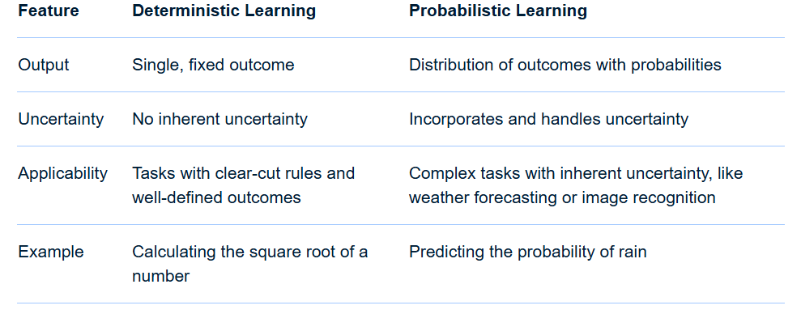
Deterministic vs Probabilistic Learning
In essence: Deterministic learning provides a clear and precise answer, while probabilistic learning offers a range of possibilities and their likelihoods, allowing for a more nuanced understanding of uncertain situations.
For Further Exploration –
Probabilistic vs. Deterministic Models in AI/ML: A Detailed Explanation
What is Deterministic/Probabilistic Data? | Definition from TechTarget
Probabilistic and Deterministic Results in AI Systems - Gaine Technology
What is the difference between deterministic and stochastic models?
Deterministic vs Stochastic - Machine Learning Fundamentals

Slide 15
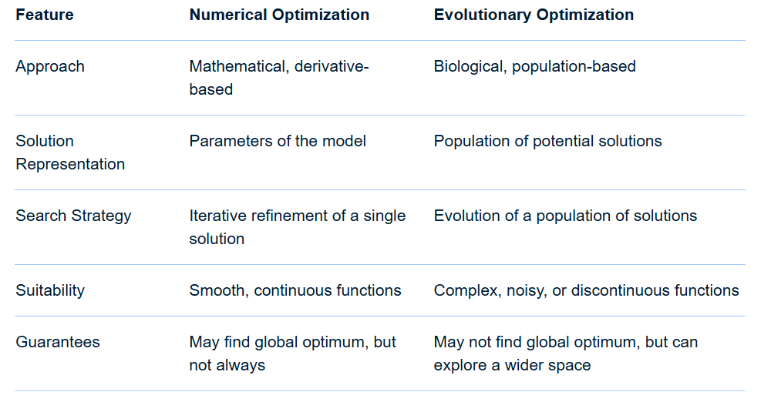
Classical/Numerical vs Evolutionary Optimisation
For Further Exploration –
Genetic and Evolutionary Algorithms Versus Classical Optimization
About OR-Tools | Google for Developers
Awesome-Operations-Research
Parallel Numerical Algorithms
Optimization Algorithms
genetic-algorithms
Artificial-Intelligence-for-Big-Data
Hands-On-Genetic-Algorithms-with-Python
Principles of Soft Computing,

Slide 16
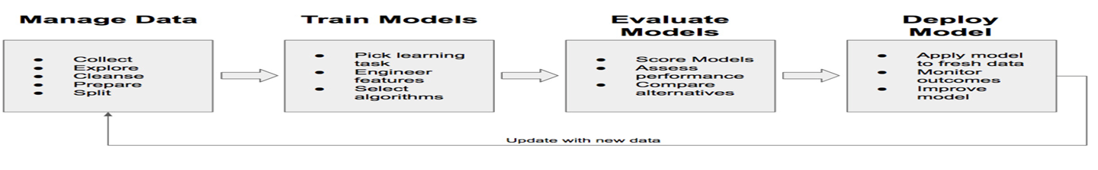
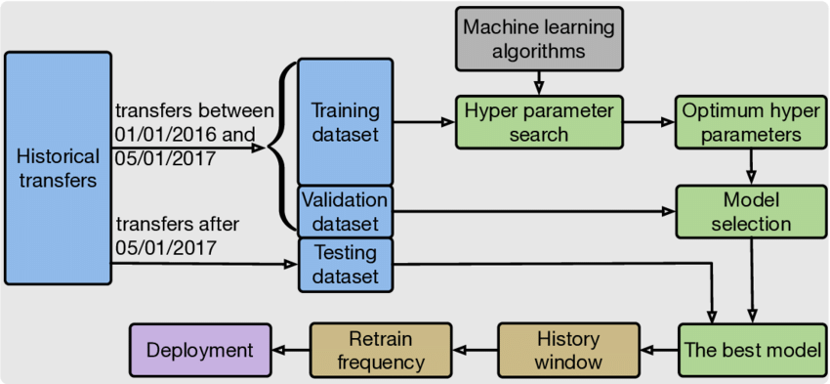
ML Modelling Workflow

Slide 17
ML Modelling Workflow (Steps)
Data Seggregation - The input data needs to be segregated into –
i) Training set - say 60%.this is the data that we will train our model(say to fit the model to the data i.e. to find the function f)
ii) Validation set - say 20%. this is needed to validate how good is our model & used in the Evaluation phase. Above segregation can be done based on 60-20(or some other % based distribution) rule or something as complex as k-fold Cross-Validation
iii) Test set - say 20%. This is needed to provide an unbiased evaluation of a final model to fit on the training dataset.
For more details refer What is the Difference Between Test and Validation Datasets & Time based splitting and determining if Train & Test data come from the same distribution

Slide 18
ML Modelling Workflow (Steps)
Model Selection & Training - Do the training on the training set to fit/find the model. Here a decision you have to take is to use classical ML or DL algos. General thumb rule is to use classical ML algos for structured/tabular data(except time-series data & graph data) & to use DL techniques for unstructured data(text, speech, music, images, videos etc), time-series data & graph data. Also, in case of classical ML algos, understanding of tree based models(number of tress & levels within the trees etc) is crucial too. An important concept related to training is Cost/Loss function(which needs to be converged so that the error <= threshold value & thereby we will get the optimal parameter values) & for that, can refer –
i)Cost/Loss function – Loss function – Wikipedia, How are the cost functions for Neural Networks derived & Difference Between the Cost, Loss, and the Objective Function
ii) Different types of Cost/Loss functions used in classic ml & neural nets - A Simple Understanding of the ML Landscape with Various Cost Functions!, The Role of Cost Functions in Machine Learning: Types, Significance, and Impact on Model Performance, What is Cost Function in Machine Learning & A list of cost functions used in neural networks, alongside applications

Slide 19
ML Modelling Workflow (Steps)
iii) Cost/Loss functions available in Keras & Pytorch – Keras Loss Functions: Everything You Need to Know & PyTorch Loss Functions: The Ultimate Guide
Another important concept is to use some Optimisation technique(s) to optimise the cost function (e.g. to minimise the loss) . Generally, for deterministic & stochastic/probabilistic data we use different techniques as depicted in Essential-Math-For-AI. Although in this depiction it shows that for probabilistic data, MLE & joint probability distribution should be used but that’s actually the case for independent events as mentioned in Calculate Maximum Likelihood Estimator with Newton-Raphson Method using R. For dependent events, we should use Bayesian Inference(bayesian_inference_basic_tutorial.pdf). Another relevant article is MLE, MAP and Bayesian Inference. Similar logic can be extended to deterministic/probabilistic Embeddings. Embeddings will be discussed later. Now the aforementioned optimisation techniques are to estimate optimal values of parameters of the function & not hyper-parameters , a concept explained later
A good starting point for various Optimisation techniques are - Understanding Optimization Algorithms in Machine Learning, Optimization Essentials for Machine Learning & 6 Continuous Optimisation with Iterative Algorithms
Also , training can be done in a distributed way via data or model parallelism & for that refer Understanding Data Parallelism in Machine Learning | Telesens & Introduction to Model Parallelism - Amazon SageMaker AI

Slide 20
ML Modelling Workflow (Steps)
Evaluation - We calculate various evaluation metrics(based on which we decide how good our model is) for various ML algos using the validation set data e.g . for regression we generally use Evaluation Metrics for Your Regression Model while for classification we can use Classification Evaluation Metrics. For the majority of most important metrics, refer How to Evaluate Clustering Algorithms?, Performance Metrics in Machine Learning & Fundamentals of Machine Learning Model Evaluation
Similarly , there are different evaluation metrics for time-series data, graph data, nlp, cv etc
A concept related to Metrics Evaluation is Sensitivity vs Specificity & for that one can refer Sensitivity and specificity
Model experimentation(Retraining[if needed]) - if we are not satisfied with the evaluation metrics, we can try any/some/all the following –
a) cleaning the data more in some other ways or re-sampling or trying other different ways of feature engineering
b) using some different ML algo
c) changing the cost function or parameter optimiser or both
d) Regularisation - if your model works great with the training data but works very poorly with actual/test data that means the data is over-fitted & to overcome overfitting, we use various regularisation techniques e.g. in regression we can use lasso(L1)/ridge(L2)[L2 vs L1 Regularization in Machine Learning & Everything you wanted to know about Lasso & Ridge Regression] while in DL networks we can use Dropout(& other) technique(s).

Slide 21
ML Modelling Workflow (Steps)
Related to overfitting is the concept of “bias vs variance” which is well explained at Machine Learning Fundamentals: Bias and Variance.
Some other good relevant articles are Regularization (mathematics) - Wikipedia , Intuitive Understanding of Bias and Variance Trade-Off, How To Address Bias-Variance Tradeoff in Machine Learning & 5 ways to achieve right balance of Bias and Variance in ML model
For more in-depth details, refer The-Regularization-Cookbook
HyperParameter tuning - Any ML process can be defined as ML = (Representation) + Objective/Training function + Optimisation(e.g. minimise some loss function or converge a function or find the MLE of some joint Probability Distribution) . As of now, just keep in mind that Representation is needed only for unstructured data(& not needed for structured/tabular data) & we need to do optimisation in any ML algo for any data(structured/unstructured) & while doing that we use some parameters called HyperParameters(e.g. epoch size, batch size, learning rate etc). The difference between parameters & hyper-parameters is that parameters are kind of outputs we want to find out to define the model properly while hyper-parameters are configurable input parameters that we use as part of the optimisation process. For hyper-parameter optimisation(i.e. finding optimal values of hyper-parameters) we can use Grid Search(human intervention required)/Randomised Search(fully automated) techniques.Also Bayesian inference techniques is sometimes used for hyper-parameter tuning. Some good relevant articles are - Difference Between a Batch and an Epoch in a Neural Network & How to Configure the Learning Rate When Training Deep Learning Neural Networks

Slide 22
ML Modelling Workflow (Steps)
For a somewhat detailed account of most of the optimisation techniques used(for parameters/hyper-parameters), refer ML Optimization Methods and Techniques. A related topic is ML Model Convergence & for that refer A Gentle Introduction to Premature Convergence.
For more in-depth details on Hyperparameter Tuning, refer Hyperparameter-Tuning-with-Python
Prediction - if we are satisfied with the evaluation metrics then predict the outcome on your test(& actual) data.
For Further Exploration -
Steps in Machine Learning: A Comprehensive Guide
4 Stages of the Machine Learning (ML) Modeling Cycle
About-loss-and-loss-functions
The-Little-Book-of-ML-Metrics
Calibration of Machine Learning Models
How to select a machine learning algorithm - Azure Machine Learning | Microsoft Learn
Machine Learning Algorithm Cheat Sheet
Hands-On-Simulation-Modeling-with-Python
PracticalSimulations
Instance-based vs Model-based Learning

Slide 23
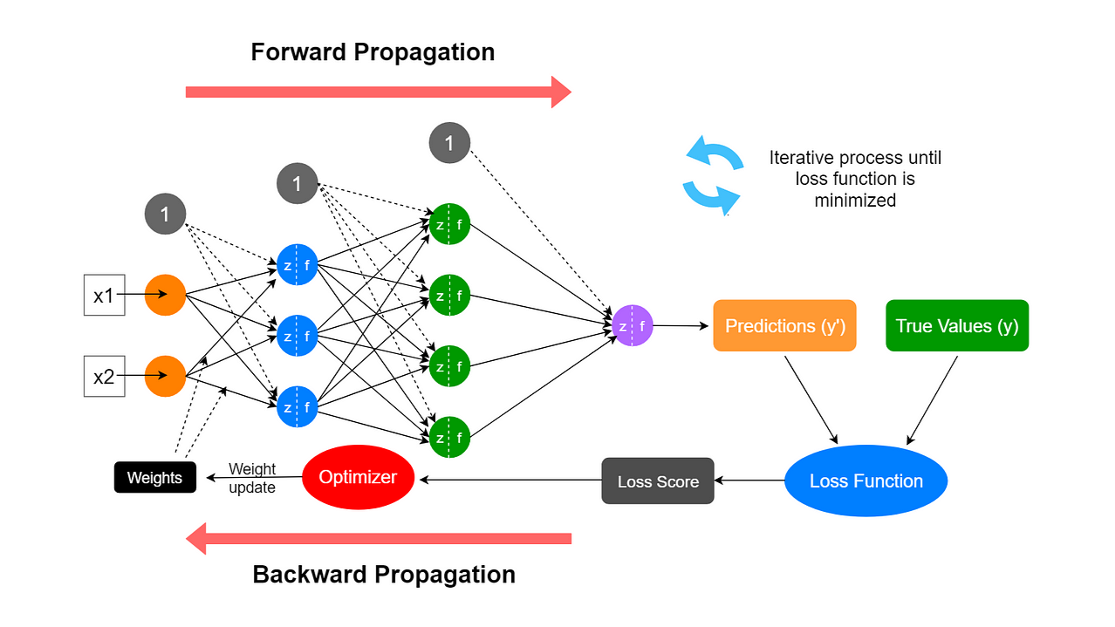
Forward and Backward Propagation in Deep Learning
For Further Exploration –
Forward Propagation in Neural Networks
Activation functions in Neural Networks
Dropout in neural networks: what it is and how it works
Grokking-Deep-Learning
Enhancing-Deep-Learning-with-Bayesian-Inference
Loss Functions and Optimization Algorithms. Demystified.
Optimizers in Deep Learning

Slide 24
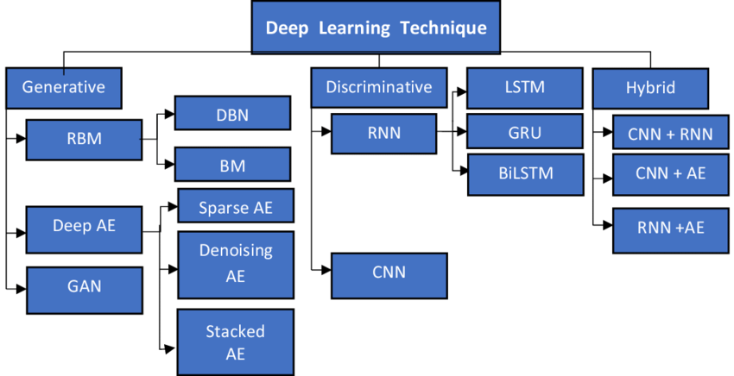
Deep Learning Architectures
For Further Exploration –
Generative models vs Discriminative models for Deep Learning.
Decoding Generative and Discriminative Models
8 Deep Learning Architectures Data Scientists Must Master
Deep learning architectures

Slide 25
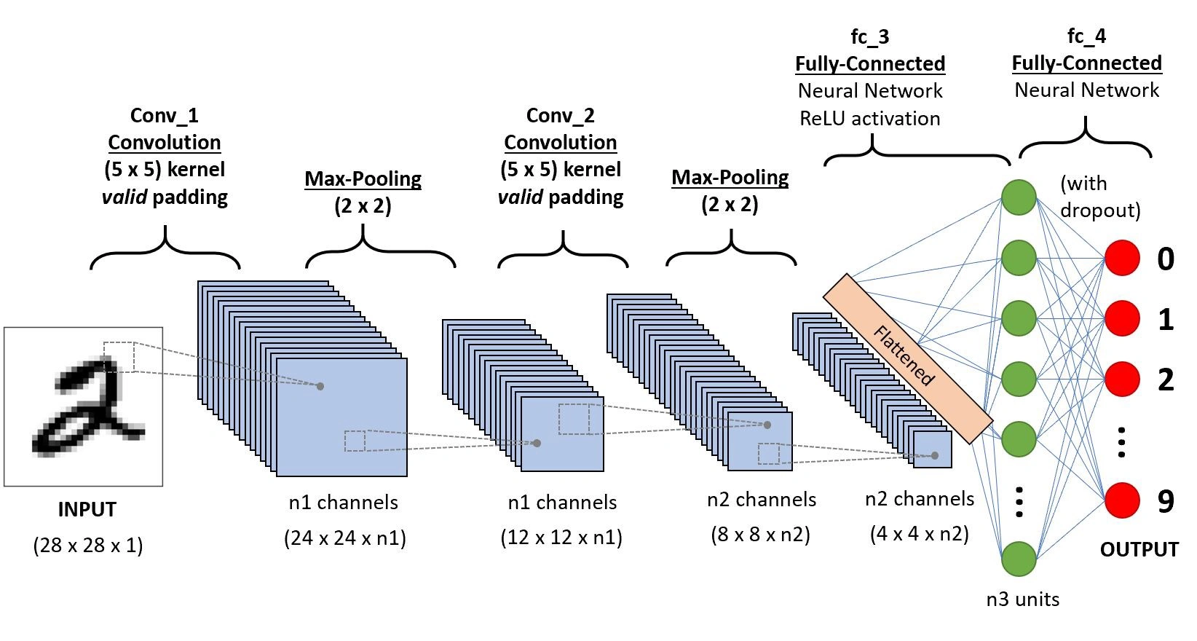
CNN Architecture
For Further Exploration –
Intuitive Guide to Convolution
Different Types of CNN Architectures

Slide 26
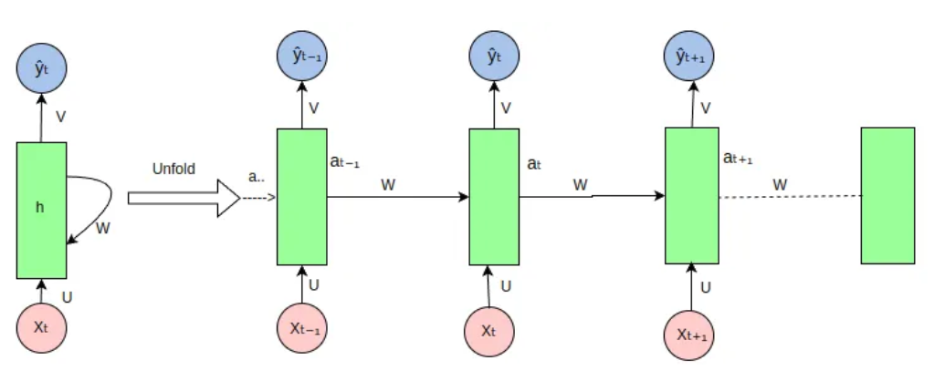
RNN Architecture
For Further Exploration –
The intuition behind recurrent neural networks
Sequence Models & Recurrent Neural Networks (RNNs)
RNN vs LSTM vs GRU
Encoders-Decoders, Sequence to Sequence Architecture.
Recurrent Neural Networks (RNNs): Challenges and Limitations
ML For Sequential Data

Slide 27
Distributed Representation/Embedding
For an intuitive understanding of Word2Vec & Embeddings in general refer Word Embeddings and Word2Vec Clearly Explained. Basically here neural networks is used to convert the unstructured data to embeddings(vectors/numbers). word2vec was the 1st embedding developed to convert a word into embedding. Basically, if there is some text like “I have invested in the Microsoft stock” then each word will be represented as some embedding(vector) in the vector space. And if I get the words “banking” or “finance” from some other texts corpora and convert them into vectors alongwith the aforementioned text then in the vector space the words viz. invest(base word for invested), bank(base word for banking) & finance will be somewhere nearby since in the world-wide text corpus bank, invest, finance are contextually somewhat related/similar. Also embeddings(matrices) formed are low dimensional matrices(implicitly applies dimensionality reduction).
So we see 2 benefits of using Embeddings –
a) The matrices formed are low dimensional dense matrices & so occupies less space.
b) The matrices carries semantics & so the words like invest, bank & finance are nearby in the vector space.
Now similar to words, we can have Embeddings for sentences & documents using a technique called Semantic Composition.And similar to Embeddings for text we can have Embeddings for sections of an image, a whole image or a whole video or some time-series sequence data or edges/nodes of a graph(or a whole graph itself) & other types of unstructured data as well & then even sky is not the limit.

Slide 28
Embeddings and Vector DBs for Enterprise/Web Search
In Enterprise search there are mainly 2 ways to search data –
a)Using DB columns value wherein we search for some DB column values using Sql & where clause with proper indexing applied to the columns mentioned in the where clause.
b) Free Text search - say there is some text in some DB column “I invested in Microsoft stock” & here there can be 2 requirements-
i) return this column text if the user searches for “invest” or “invested”. That’s normal free text search done by tools like Apache Solr, ElasticSearch or OpenSearch(all these tools mostly uses the concept of inverted index). Most of these tools use (partial) exact match based search.
ii) return this column text if the user searches bank or finance since these words are somewhat related to the word invest in the global text corpora. That’s Semantic Search & for that we need Embeddings(for Semantic match).
But why do we need Vector DBs? - that’s to store the vector space & the associated embeddings in the most optimal way (for later usage as part of search query). So what’s the whole Embeddings & Vector DBs based search process like –
a) via some offline process convert the text corpora into word/sentence Embeddings & document Embeddings & store the vector space & associated Embeddings in the Vector DBs.
b) When the user searches for some word/sentence, convert it into word/sentence embedding & then check in the documents embeddings, which word/sentence Embeddings are near-by, using vector distance formulas like Euclidean Distance or Cosine Distance or Manhattan Distance & then return those documents as search results.
Similar to free text search, Embeddings & Vector DBs can be used for sections of image search or a whole image search or a video search or for searching all videos which contains some image or even multi-modal search & many more similar search apps. For an intuitive article on Free Text Search using Embeddings refer How to build a search engine with word embeddings An article relating to Advanced(& much faster) way to do search using both Graph & Vector DBs is explained in This LinkedIn Post

Slide 29
Rankings in Embeddings Based Search
For any Search Ranking problem it’s ideal to visualise the Search problem as a graph with nodes(e.g. containing the document embeddings) & edges(e.g. for the relation between the document embeddings) so that we can calculate ranks associated with both nodes & edges & then applying some weight factor to these ranks, we can calculate the overall rank of the document. So in case of web pages(as document texts), we can convert all the word/sentence/document texts into corresponding Embeddings & store them in Vector DBs & when the user queries some text(word/sentence), convert that into corresponding Embeddings & then the search results should be sorted based on a combination of weightage given to Nodes & Edges Ranking
a) Nodes Ranking - here ideally it should 1st show the result corresponding to [partial] exact match & then other results based on sorted near-by distance. This is more of Content Relevance Ranking. For more details on (classical) Relevance Ranking Algorithms refer Introduction to Ranking Algorithms, Ranking Algorithms & Types, Ranking Entities with Multi-Criteria Decision Making Methods(MCDM) & Ranking and learning to rank - Practical Recommender Systems
b) Link/Edge Ranking - e.g. Google uses PageRank algo using complex distributed linear algebra techniques(mainly solving system of linear equations [wherein the parameters of the equations are probabilities] & using EigenValue/EigenVector concepts). The main logic used here is to give more importance to a document which has more links referring to it. For an intuitive understanding of PageRank, refer Understanding Page Rank. In simple terms. By the way, for some complex search requirement, one may have to develop his/her own custom Link/Edge Ranking algo. For more details on various Link/Edge Ranking Algorithms, refer Link Analysis Algorithms Explained & PageRank.pdf . For a generic Ranking System refer AMultitaskRankingSystem:

Slide 30
Contextual & Positional Encoding
Contextual embeddings and positional embeddings are both crucial for NLP models like Transformers, but they serve different purposes. Contextual embeddings capture the meaning of words in relation to their surrounding words, allowing for different representations of the same word in different contexts. Positional embeddings, on the other hand, provide the model with information about the position of each word in a sequence, helping it understand the order of words.
Here's a more detailed breakdown:
Contextual Embeddings:
Dynamic:They adapt to the context, unlike static embeddings which represent words with fixed vectors.
Purpose:Allow a word to have multiple representations based on its surrounding context, enabling better handling of word sense disambiguation and polysemy.
Example:ELMo and BERT are popular models that generate contextual embeddings by considering the surrounding words.
Positional Embeddings:
Purpose:Provide the model with information about the position of each word in a sequence, which is crucial for understanding the order of words.
How it works:Transformers, which process words in parallel, need positional embeddings to understand the order of words in a sentence.
Example:Sine and cosine functions are often used to generate positional embeddings, according to an explanation on Medium.
Key Differences:
Focus:Contextual embeddings focus on the meaning of words in relation to their context, while positional embeddings focus on the order of words in a sequence.
Dynamic vs. Static:Contextual embeddings are dynamic, changing based on context, while positional embeddings are generally static within a given sequence.
Application:Contextual embeddings are useful for tasks that require nuanced understanding of language, such as sentiment analysis and text generation, while positional embeddings are crucial for any NLP model that relies on the order of words.
For Further Exploration –
How to build custom NER model with Context based Word Embeddings in Vernacular languages
A Gentle Introduction to Positional Encoding in Transformer Models, Part 1 - MachineLearningMastery.com

Slide 31
Self Attention, Cross Attention & Multihead Attention
Self-attention, cross-attention, and multi-head attention are all variations of the attention mechanism used in deep learning models, particularly in transformers. Self-attention focuses on relationships within a single sequence, while cross-attention bridges the gap between two distinct sequences. Multi-head attention is a technique that uses multiple parallel attention mechanisms to capture different aspects of a sequence, often used in conjunction with self-attention or cross-attention.
Self-Attention:
Focus: Within a single sequence, enabling a model to attend to different positions within that sequence to understand its meaning.
Mechanism: Transforms an input sequence into query, key, and value vectors. These vectors are then used to compute attention weights, effectively determining the importance of each element in the sequence relative to others.
Applications: Commonly used in encoders and decoders of transformer models, capturing dependencies within a single input sequence.
Cross-Attention:
Focus: Between two different sequences, allowing models to relate information from one sequence to another.
Mechanism:Similar to self-attention, it utilizes query, key, and value vectors, but these vectors come from different sequences.
Applications:Crucial in encoder-decoder architectures, enabling information transfer between an input sequence and an output sequence.
Multi-Head Attention:
Focus:Enhances the ability of attention mechanisms to capture complex relationships by using multiple "heads".
Mechanism:Divides the input sequence into multiple "heads," each of which independently calculates attention weights. The outputs of these heads are then combined to produce a final output.
Applications:Used in conjunction with self-attention and cross-attention, particularly in transformer models, allowing for more nuanced and comprehensive understanding of sequences.

Slide 32
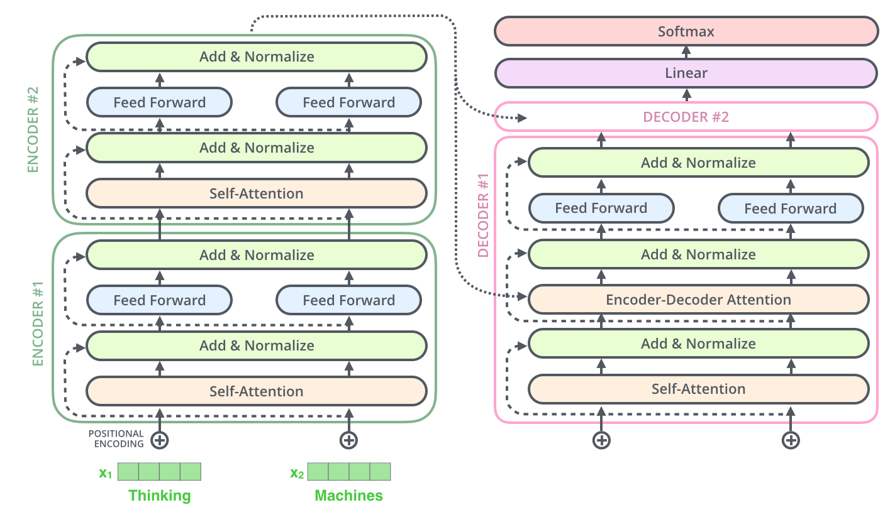
Tranformer Architecture
Refer The Illustrated Transformer & Transformer Neural Networks to understand the intricate details of the Transformer Architecture

Slide 33
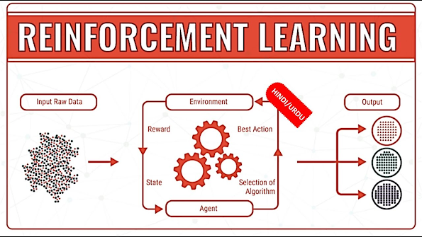
Reinforcement Learning
For Further Exploration –
Reinforcement Learning, Intuition, and Abductive Reasoning
Algorithms for Decision Making
Some Good RL Resources – I
Some Good RL Resources - II

Slide 34
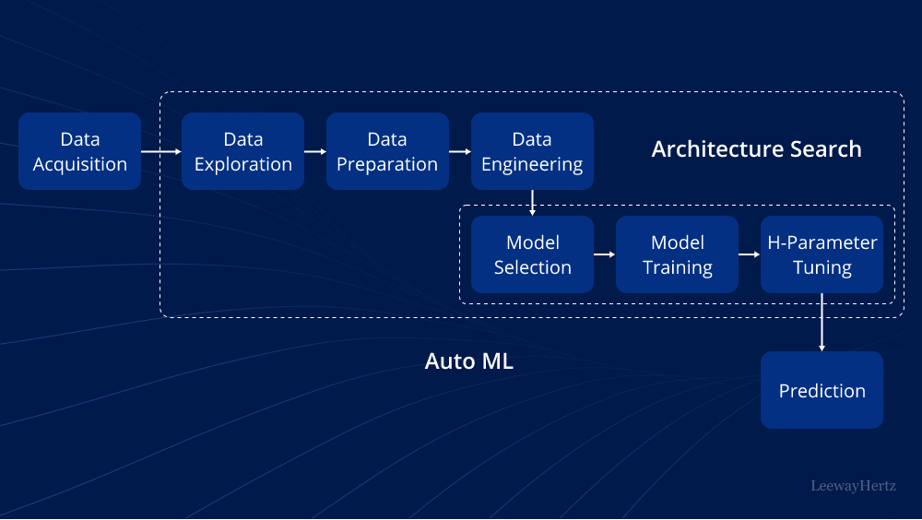
AutoML(Search for Best ML/DL Architecture)
For Further Exploration –
AutoML: Components, techniques, working, tools, platforms and use cases
Awesome-AutoML
Awesome-AutoML-Books
EvolutionaryDeepLearning

Slide 35
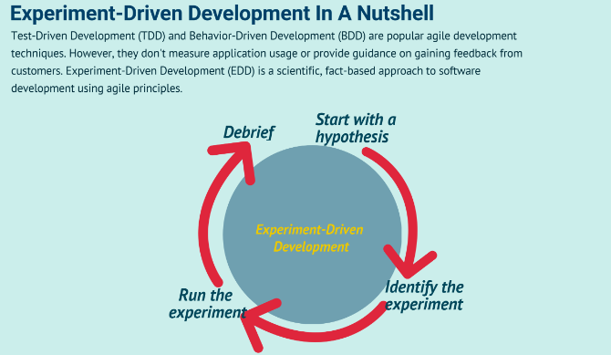
Experiment Driven Development(using A/B [Statistical] Testing)
Feature Flags(based frameworks) can be useful for A/B Testing.
For Further Exploration-
Experiment-Driven Development In A Nutshell
Experimentation-driven development
Experiment Driven Development
How to apply hypothesis-driven development
Data-driven hypothesis development
Micro-Experiments and Experiment Driven Development
A/B Testing Simplified: Steps to Data-Driven Decisions
A/B testing - Wikipedia
15 Math Concepts Every Data Scientist Should Know (Check especially Chapters 2 & 7 for A/B Testing)
A/B Testing Statistics: An Intuitive Guide For Non-Mathematicians
A/B Testing: A Complete Guide to Statistical Testing
A/B Testing Statistics Made Simple
Statistical Significance in A/B Testing
A-B-Testing
The ultimate guide to A/B testing
Experimentation for Engineers: From A/B Testing to Bayesian Optimization
A Summary of Udacity A/B Testing Course
Experiment-Driven Development: A/B Testing and Beyond with AI

Slide 36
Further References
Practical Machine Learning with Python
Artificial Intelligence: A Modern Approach, 4th US ed.
Hands-On Machine Learning with Scikit-Learn, Keras, and TensorFlow: Concepts, Tools, and Techniques
Trevor Hastie’s Books
valeman/awesome-conformal-prediction
Speech and Language Processing
Representation Learning for Natural Language Processing
Introduction to Large Language Models
Active Learning and Transfer Learning
Transfer Learning vs Fine Tuning LLMs: Differences
awesome-llm-books
awesome-vector-database
Graph Representation Learning
awesome-graph-universe
Computer Vision and Deep Learning Courses - CVDL Master
Generative Deep Learning: Teaching Machines To Paint, Write, Compose, and Play
The Theory and Practice of Enterprise AI
Agentic Artificial Intelligence
Compendium-of-free-ML-reading-resources
V7 Blog
Machine Learning in Plain English – Medium
Covariance vs. Correlation: Differences to Know
Introduction to the Correlation Matrix
Analysis of covariance
Intuition Behind Kernels in Machine Learning
What is Classification Threshold
Ridhima Kumar – Medium
Venkat Raman | LinkedIn

Slide 37
Thank You

